Slide 1

Experimental validation of three nonlinear MPP Solar tracking techniques
By
Yogindersing Gajadur
and
Dr. S Z Sayed Hassen

Slide 2
Aim of this work
Compare the performance of three Maximum Power Point Tracking (MPPT) techniques namely;
Incremental Conductance (InCond)
Extremum Seeking Control (ESC) and
Particle Swarm Optimization (PSO)

Slide 3
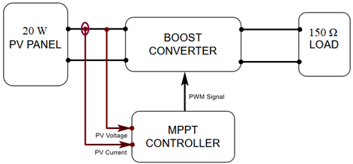
Proposed Controller

Slide 4
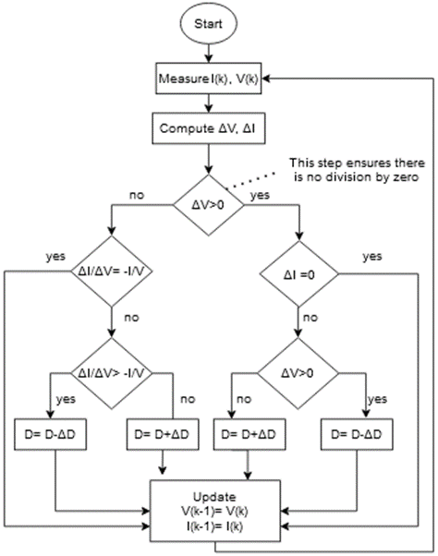
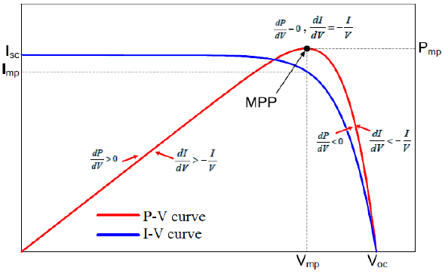
Working principles of the proposed algorithms – Incremental Conductance

Slide 5
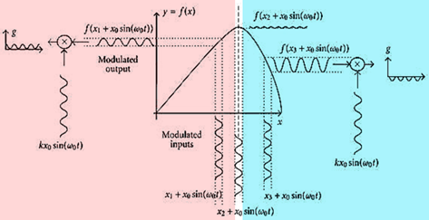
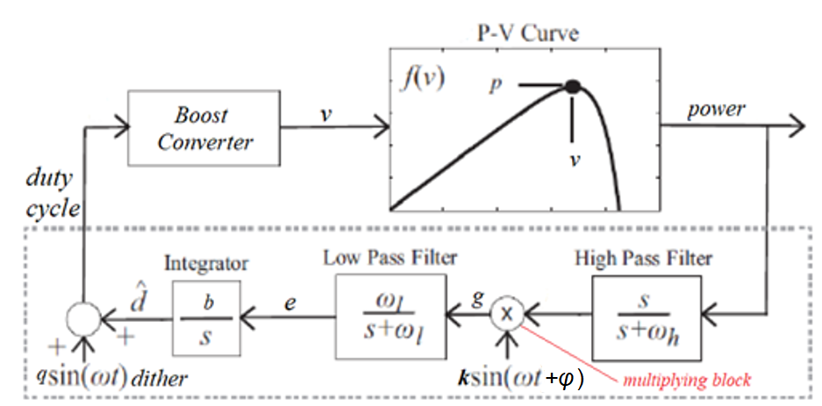
Extremum Seeking Control
Parameter | Value
High-pass cutoff frequency (w_{h}) | 6 rad/s
Low-pass cutoff frequency (w_{l}) | 16 rad/s
Dither’s frequency (w) | 40π rad/s (20Hz)
Dither’s amplitude (q) | 0.01
Phase lead introduced by the dither (φ) | +10°
Gain (k) | 1000
Gain of integrator (b) | 0.6

Slide 6
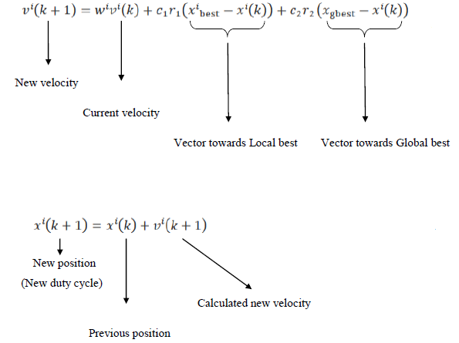
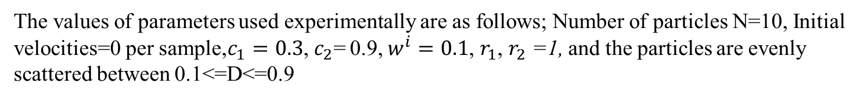
Particle Swarm Optimization
The values of parameters used experimentally are as follows; Number of particles N=10, Initial velocities=0 per sample,$c_{1}=0.3$,${ c}_{2}$= 0.9, $w^{i}=0.1$, $r_{1}$, $r_{2}$ =1, and the particles are evenly scattered between 0.1<=D<=0.9

Slide 7
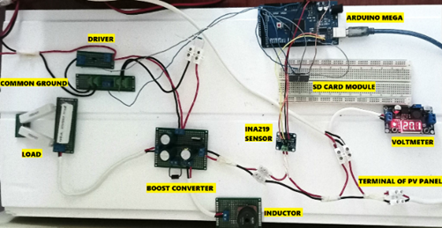
Experimental Setup

Slide 8
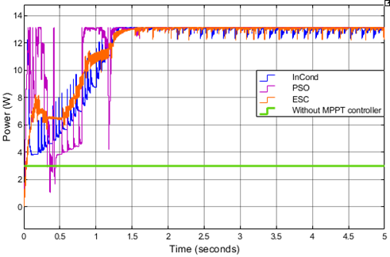
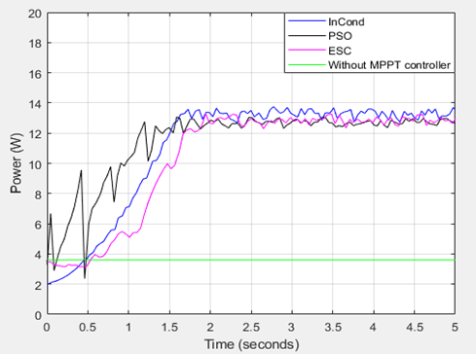
Results- Power Graphs
Simulated graphs
Experimental graphs

Slide 9
Comparison of results and conclusion
Algorithm |  | InCond | PSO | ESC
Tracking time (s) | Simulation | 1.325 | 1.277 | 1.537
 | Experiment | 1.728 | 1.588 | 1.942
Amplitude of oscillations (W) | Simulation | 0.897 | 0.351 | 0.964
 | Experiment | 1.11 | 0.74 | 0.980
Power when load directly connected (W) | Simulation | 3.00
 | Experiment | 3.61

Slide 10
Thank you

